Slide 1
Chapter 18
Renaissance and Reformation in Sixteenth-Century Northern Europe

Slide 2
Learning Objectives
Trace the spread of Italian Renaissance Style throughout Europe.
Define the impact of the Reformation on art making in Northern Europe.
Investigate sixteenth century patrons at the courts and in urban centers.
Identify new themes and subjects in sixteenth century Northern European art.
Recognize the works and influences on key artists of the period.

Slide 3
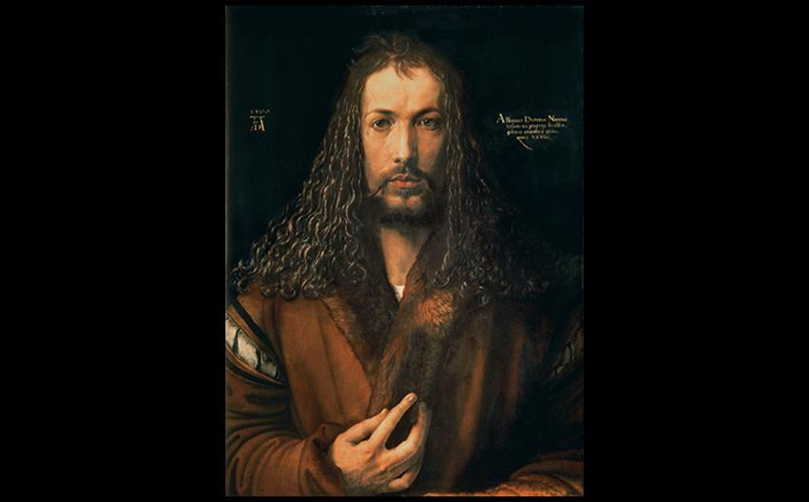
Albrecht Dürer SELF-PORTRAIT 1500. Signed "Albrecht Dürer of Nuremberg…age 28." Oil on wood panel, 26-1/4" × 19-1/4" (66.3 × 49 cm). Alte Pinakothek, Munich. © 2016. Photo Scala, Florence/bpk, Bildagentur für Kunst, Kultur und Geschichte, Berlin.
Notes:
Albrecht Dürer SELF-PORTRAIT 1500. Signed "Albrecht Dürer of Nuremberg…age 28." Oil on wood panel, 26-1/4" × 19-1/4" (66.3 × 49 cm). Alte Pinakothek, Munich. © 2016. Photo Scala, Florence/bpk, Bildagentur für Kunst, Kultur und Geschichte, Berlin.

Slide 4
The Reformation and the Arts
Two important reformers were Desiderius Erasmus in Holland, and Martin Luther in Germany.
Increased literacy and widespread use of the printing press allowed many Europeans to enter religious debate.
Years of political and religious strife had a grave impact on artists.
There was a mass destruction of works.

Slide 5
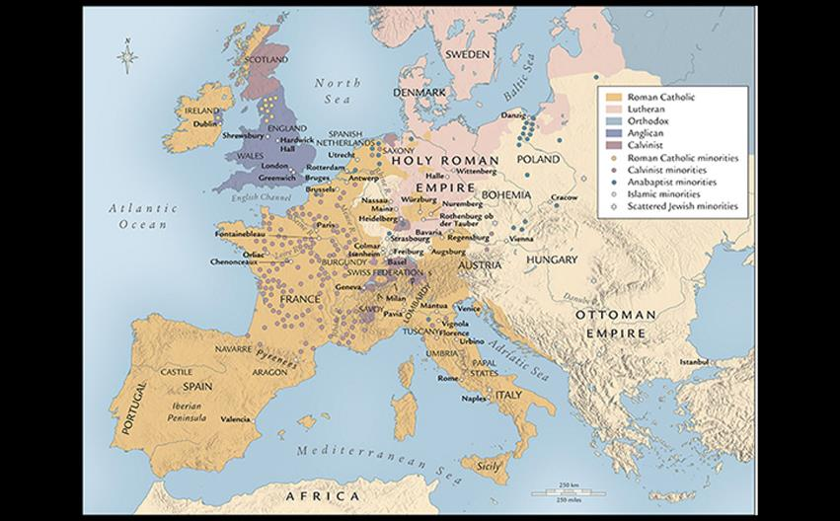
WESTERN EUROPE DURING THE REFORMATION, C. 1560 Sixteenth-century Europe remained largely Roman Catholic, except in Switzerland and the far north, where the impact of the Protestant Reformation was strongest.
Notes:
WESTERN EUROPE DURING THE REFORMATION, C. 1560 Sixteenth-century Europe remained largely Roman Catholic, except in Switzerland and the far north, where the impact of the Protestant Reformation was strongest.

Slide 6
Technique: German Metalwork: A Collaborative Venture
Hans Krug and his sons were fine metalworkers in Nuremburg.
The silver-gilt Apple Cup was a display piece for the wealthy.
Several artists worked together to produce such pieces: one each to draw, model, and cast it in metal.
Designers created a wooden form for the goldsmith to follow.

Slide 7
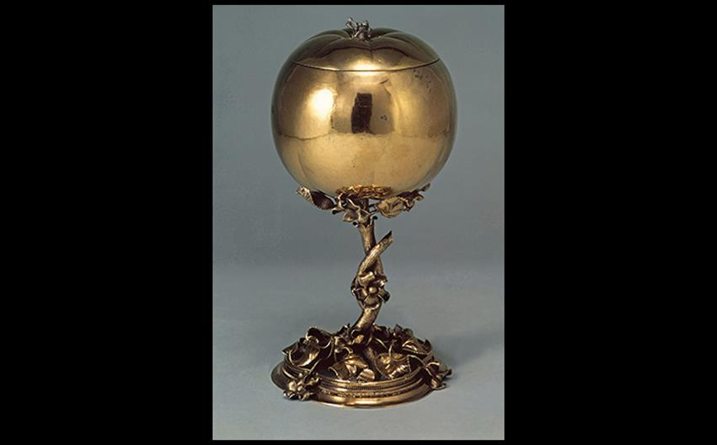
APPLE CUP c. 1510–1515. Gilt silver, height 8-1/2" (21.5 cm). Germanisches Nationalmuseum, Nuremberg. © 2016. Photo Scala, Florence.
Notes:
APPLE CUP c. 1510–1515. Gilt silver, height 8-1/2" (21.5 cm). Germanisches Nationalmuseum, Nuremberg. © 2016. Photo Scala, Florence.

Slide 8
Germany
Religious upheavals and iconoclastic purges took their toll on the arts at mid century.
German merchants and bankers accumulated their own wealth, and were able to order portraits of themselves and furnishings for their residences.

Slide 9
Sculpture (1 of 3)
German produced most original work in fine-grained limewood, often gilded and painted.
Tilman Riemenschneider
His workshop specialized in wood and stone sculpture.
The Altarpiece of the Holy Blood stands about 30 feet high.
Its subject is the Last Supper.

Slide 10
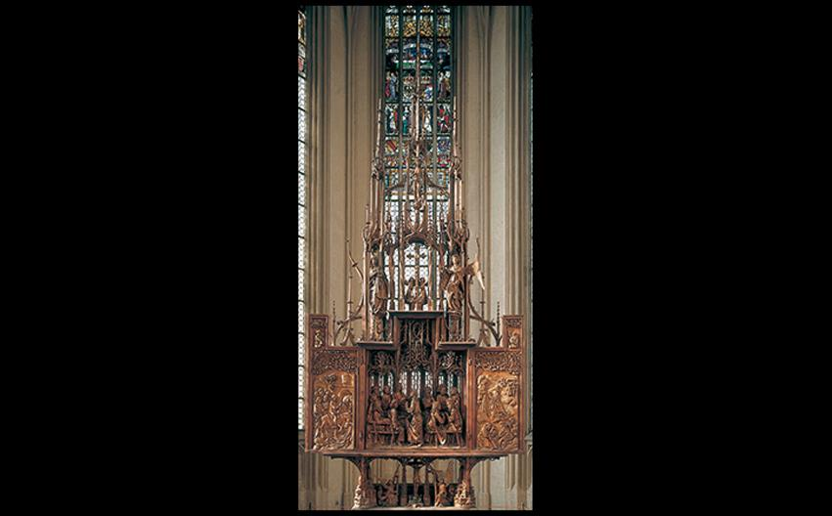
Tilman Riemenschneider ALTARPIECE OF THE HOLY BLOOD (OPEN) Sankt Jakobskirche (church of St. James), Rothenburg ob der Tauber, Germany. Center, Last Supper. c. 1499–1505. Limewood, glass, height of tallest figure 39" (99.1 cm), height of altar 29'6" (9 m). © akg-images/Erich Lessing.
Notes:
Tilman Riemenschneider ALTARPIECE OF THE HOLY BLOOD (OPEN) Sankt Jakobskirche (church of St. James), Rothenburg ob der Tauber, Germany. Center, Last Supper. c. 1499–1505. Limewood, glass, height of tallest figure 39" (99.1 cm), height of altar 29'6" (9 m). © akg-images/Erich Lessing.

Slide 11
Sculpture (2 of 3)
Tilman Riemenschneider
The artist chose to put Judas at the center of the Altarpiece's main scene.
Rather than creating individual portraits, Riemenschneider repeated a set of established facial types.
Details of figures and environment were carved into the wood itself so the artist could introduce a natural wood finish.

Slide 12
Sculpture (3 of 3)
Nikolaus Hagenauer
Sculptor Hagenauer carved an altarpiece for the abbey of St. Anthony in Isenheim, near a hospital that specialized in caring for patients with skin diseases.
SS. Anthony, Jerome, and Augustine are featured in the shrine.
Jesus and his apostles appear below in the predella.

Slide 13
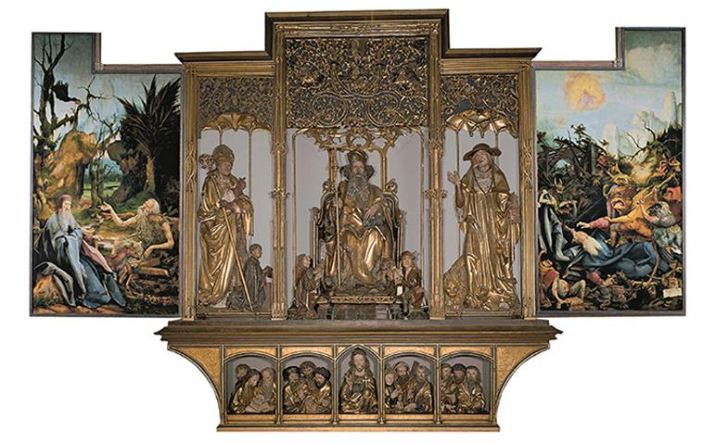
Nikolaus Hagenauer (central panels and predella) and Matthias Grünewald (wings) ISENHEIM ALTARPIECE (OPEN) From the Community of St. Anthony, Isenheim, Alsace, France. Center panels and predella: St. Anthony Enthroned between SS. Augustine and Jerome, Christ and the Apostles, c. 1500. Painted and gilt limewood, center panel 9'9-1/2" × 10'9" (2.97 × 3.28 m), predella 2'5-1/2" × 11'2" (0.75 × 3.4 m). Wings: SS. Anthony and Paul the Hermit (left); The Temptation of St. Anthony (right). 1510–1515. Oil on wood panel, 8'2-1/2" × 3'-1/2" (2.49 × 0.93 m).Musée d'Unterlinden, Colmar, France. Bridgeman Images
Notes:
Nikolaus Hagenauer (central panels and predella) and Matthias Grünewald (wings) ISENHEIM ALTARPIECE (OPEN) From the Community of St. Anthony, Isenheim, Alsace, France. Center panels and predella: St. Anthony Enthroned between SS. Augustine and Jerome, Christ and the Apostles, c. 1500. Painted and gilt limewood, center panel 9'9-1/2" × 10'9" (2.97 × 3.28 m), predella 2'5-1/2" × 11'2" (0.75 × 3.4 m). Wings: SS. Anthony and Paul the Hermit (left); The Temptation of St. Anthony (right). 1510–1515. Oil on wood panel, 8'2-1/2" × 3'-1/2" (2.49 × 0.93 m).Musée d'Unterlinden, Colmar, France. Bridgeman Images.

Slide 14
Painting (1 of 10)
Matthias Grünewald continued paintings with medieval mysticism and emotional spirituality.
Albrecht Dürer, in contrast, rendered his subjects with lifelike representation, using mathematical perspective and a reasoned canon of proportions.

Slide 15
Painting (2 of 10)
Matthias Grünewald
His best known work is the shutters attached to the carved Isenheim Altarpiece above.
On weekdays, a scene of the Crucifixion and Lamentation were viewable.
The tortured body of Jesus was covered with horrific details.

Slide 16
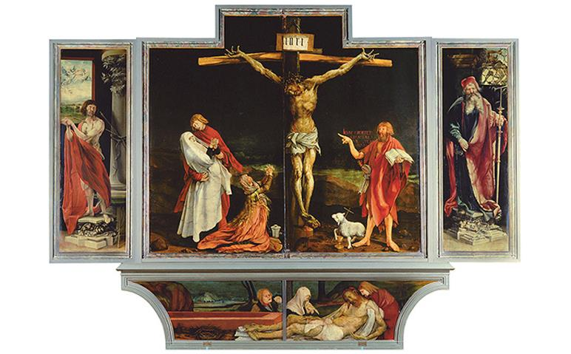
Matthias Grünewald ISENHEIM ALTARPIECE (CLOSED) From the Community of St. Anthony, Isenheim, Alsace, France. Center panels: Crucifixion; predella: Lamentation; side panels: SS. Sebastian (left) and Anthony Abbot (right). c. 1510–1515. Date 1515 on ointment jar. Oil on wood panel, center panels 9'9-1/2" × 10'9" (2.97 × 3.28 m) overall, each wing 8'2-1/2" × 3'-1/2" (2.49 × 0.93 m), predella 2'5-1/2" × 11'2" (0.75 × 3.4 m). Musée d'Unterlinden, Colmar, France. Bridgeman Images.
Notes:
Matthias Grünewald ISENHEIM ALTARPIECE (CLOSED) From the Community of St. Anthony, Isenheim, Alsace, France. Center panels: Crucifixion; predella: Lamentation; side panels: SS. Sebastian (left) and Anthony Abbot (right). c. 1510–1515. Date 1515 on ointment jar. Oil on wood panel, center panels 9'9-1/2" × 10'9" (2.97 × 3.28 m) overall, each wing 8'2-1/2" × 3'-1/2" (2.49 × 0.93 m), predella 2'5-1/2" × 11'2" (0.75 × 3.4 m). Musée d'Unterlinden, Colmar, France. Bridgeman Images.

Slide 17
Painting (3 of 10)
Matthias Grünewald
In contrast, the first opening displays joyful events of the Annunciation, Nativity, and Resurrection and was displayed on Sundays and feast days.
The second opening reveals Hagenauer's sculpture and was reserved for the festivals of St. Anthony.
Subjects turned to the life of the Saint and acknowledged patients' pain.

Slide 18
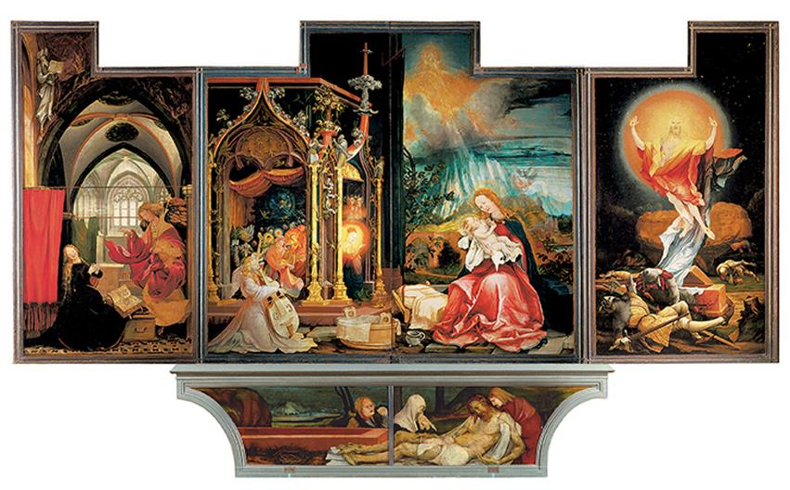
Matthias Grünewald ISENHEIM ALTARPIECE (FIRST OPENING) Left to right: Annunciation, Virgin and Child with Angels, Resurrection. c. 1510–1515. Oil on wood panel, center panel 9'9-1/2" × 10'9" (2.97 × 3.28 m) overall, each wing 8’10" × 4' 8" (2.69 × 1.42 m). Musée d'Unterlinden, Colmar, France. Bridgeman Images
Notes:
Matthias Grünewald ISENHEIM ALTARPIECE (FIRST OPENING) Left to right: Annunciation, Virgin and Child with Angels, Resurrection. c. 1510–1515. Oil on wood panel, center panel 9'9-1/2" × 10'9" (2.97 × 3.28 m) overall, each wing 8’10" × 4' 8" (2.69 × 1.42 m). Musée d'Unterlinden, Colmar, France. Bridgeman Images

Slide 19
Painting (4 of 10)
Albrecht Dürer
Based in Nuremberg, Dürer traveled to Switzerland, Italy, and Strasbourg to further his studies.
His first print publication, The Apocalypse, appeared in German and Latin editions.
The Four Horsemen of the Apocalypse shows the figures from Revelations in a compact, overlapping group.

Slide 20
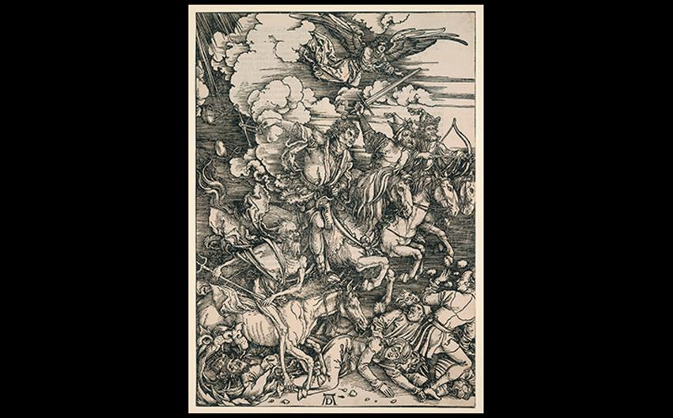
Albrecht Dürer THE FOUR HORSEMEN OF THE APOCALYPSE From The Apocalypse. 1497–1498. 1511 edition. Woodcut, 15-1/2" × 11-1/16" (39.4 × 28.1 cm). ). Yale University Art Gallery, New Haven, Connecticut. Library transfer, Gift of Paul Mellon, B.A. 1929 (1956.16.3e). Image courtesy Yale University Art Gallery.
Notes:
Albrecht Dürer THE FOUR HORSEMEN OF THE APOCALYPSE From The Apocalypse. 1497–1498. 1511 edition. Woodcut, 15-1/2" × 11-1/16" (39.4 × 28.1 cm). ). Yale University Art Gallery, New Haven, Connecticut. Library transfer, Gift of Paul Mellon, B.A. 1929 (1956.16.3e). Image courtesy Yale University Art Gallery.

Slide 21
Painting (5 of 10)
Albrecht Dürer
As early as 1494, he began to engrave metal plates himself.
Adam and Eve is one such work that identifies ideal human proportions based on Roman copies of Greek sculpture.
The four humors, or temperaments, are symbolized in the content of the work.

Slide 22
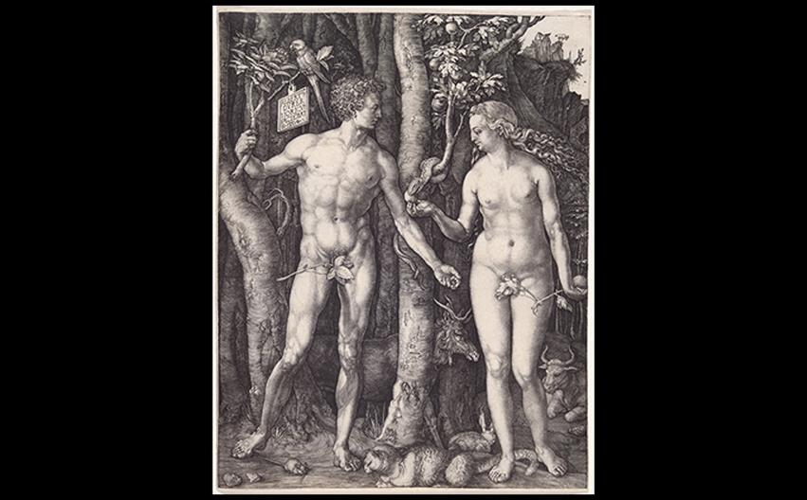
Albrecht Dürer ADAM AND EVE 1504. Engraving, 9-5/8" × 7-5/8" (244 × 19.3 cm). Yale University Art Gallery, New Haven, Connecticut. Fritz Achelis Memorial Collection, Gift of Frederic George Achelis, B.A. 1907; reacquired in 1972 with the Henry J. Heinz II, B.A. 1931, Fund; Everett V. Meeks, B.A. 1901, Fund; and Stephen Carlton Clark, B.A. 1903, Fund (1925.29). Image courtesy Yale University Art Gallery.
Notes:
Albrecht Dürer ADAM AND EVE 1504. Engraving, 9-5/8" × 7-5/8" (244 × 19.3 cm). Yale University Art Gallery, New Haven, Connecticut. Fritz Achelis Memorial Collection, Gift of Frederic George Achelis, B.A. 1907; reacquired in 1972 with the Henry J. Heinz II, B.A. 1931, Fund; Everett V. Meeks, B.A. 1901, Fund; and Stephen Carlton Clark, B.A. 1903, Fund (1925.29). Image courtesy Yale University Art Gallery.

Slide 23
Painting (6 of 10)
Albrecht Dürer
The Four Apostles demonstrates the artist's Lutheran beliefs.
An inscription on the frame warns viewers not to follow "false prophets" but to follow the word of the Bible.
It led the way for the possibility of Protestant visual art.

Slide 24
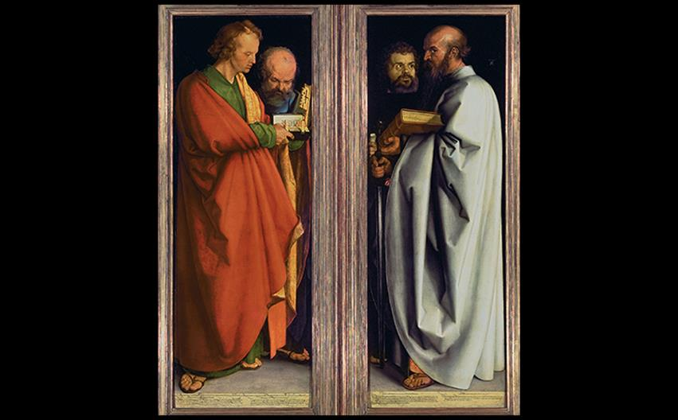
Albrecht Dürer FOUR APOSTLES 1526. Oil on wood panel, each panel 7'-1/2" × 2'6" (2.15 × 0.76 m). Alte Pinakothek, Munich. Photo © Bayer@Mitko/ARTOTHEK.
Notes:
Albrecht Dürer FOUR APOSTLES 1526. Oil on wood panel, each panel 7'-1/2" × 2'6" (2.15 × 0.76 m). Alte Pinakothek, Munich. Photo © Bayer@Mitko/ARTOTHEK.

Slide 25
Painting (7 of 10)
Cranach, Baldung, and Altdorfer
Lucas Cranach the Elder
Nymph of the Spring included a Renaissance theme of the sleeping nymph, although this nymph is not the idealized, Classical Venus.

Slide 26
Painting (8 of 10)
Cranach, Baldung, and Altdorfer
Lucas Cranach the Elder
Cranach is unconstrained by Protestant patrons; he delights in earthly things in this work, specifically lush foliage and rich red colors in the nymph's dress, necklace, and bow and quiver.

Slide 27
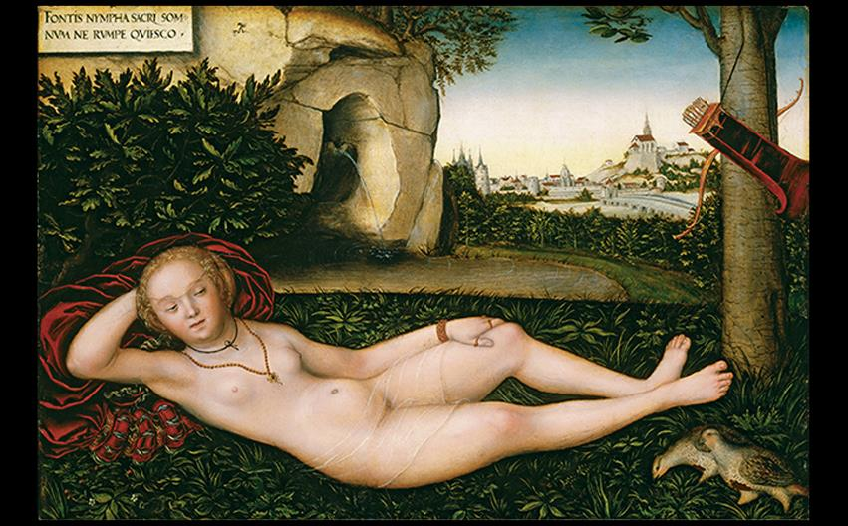
Lucas Cranach the Elder NYMPH OF THE SPRING c. 1537. Oil on panel, 19" × 28-1/2" (48.5 × 72.9 cm). National Gallery of Art, Washington, DC. Image courtesy the National Gallery of Art, Washington.
Notes:
Lucas Cranach the Elder NYMPH OF THE SPRING c. 1537. Oil on panel, 19" × 28-1/2" (48.5 × 72.9 cm). National Gallery of Art, Washington, DC. Image courtesy the National Gallery of Art, Washington.

Slide 28
Painting (9 of 10)
Cranach, Baldung, and Altdorfer
Hans Baldung Grien
Grien is known for his unique visualizations of women.
Death and the Matron juxtaposes sensuality with mortality and attraction with repulsion.
The nude expanses of the woman's flesh are contrasted with the putrid and decaying flesh of the figure of Death.

Slide 29
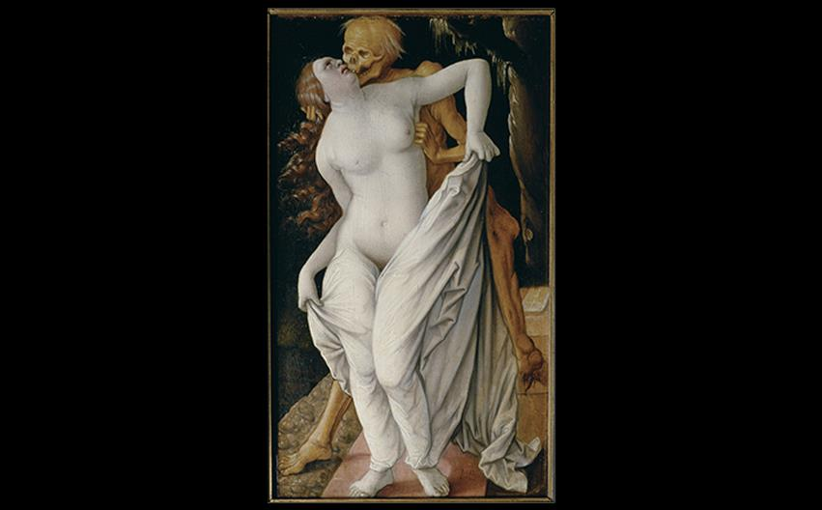
Hans Baldung Grien DEATH AND THE MATRON c. 1520–1525. Oil on wood panel, 12-3/8" × 7-3/8" (31.3 × 18.7 cm). Öffentliche Kunstsammlung, Basel. Photo © Hans Hinz/ARTOTHEK.
Notes:
Hans Baldung Grien DEATH AND THE MATRON c. 1520–1525. Oil on wood panel, 12-3/8" × 7-3/8" (31.3 × 18.7 cm). Öffentliche Kunstsammlung, Basel. Photo © Hans Hinz/ARTOTHEK.

Slide 30
Painting (10 of 10)
Cranach, Baldung, and Altdorfer
Albrecht Altdorfer
Although landscapes had no overt religious content, they could be seen as glorifying God's works on Earth.
Danube Landscape is a pure landscape painting without a narrative, subject, human figures, or religious significance.

Slide 31
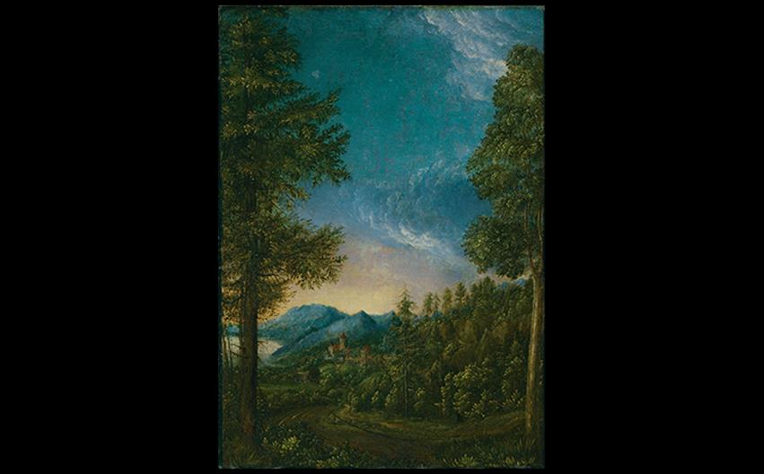
Albrecht Altdorfer DANUBE LANDSCAPE c. 1525. Oil on vellum on wood panel, 12" × 8-1/2" (30.5 × 22.2 cm). Alte Pinakothek, Munich. © 2016. Photo Scala, Florence/bpk, Bildagentur für Kunst, Kultur und Geschichte, Berlin.
Notes:
Albrecht Altdorfer DANUBE LANDSCAPE c. 1525. Oil on vellum on wood panel, 12" × 8-1/2" (30.5 × 22.2 cm). Alte Pinakothek, Munich. © 2016. Photo Scala, Florence/bpk, Bildagentur für Kunst, Kultur und Geschichte, Berlin.

Slide 32
France
Reformer John Calvin fled France to establish a theocratic state in Geneva.
Political factions favoring Catholics fought those favoring Huguenots, and Catherine de' Medici failed to balance this warring state.
Henry IV ruled with Catholicism, but established tolerance of Protestants with the Edict of Nantes in 1598.

Slide 33
Art and Its Contexts: The Castle of the Ladies
The châteaux of the Loire River Valley was built and restored by the patronage of women.
Its owners included Catherine Briconnet, Diane de Poitiers, Catherine de'Medici and Madame Dupin.
It was used as a hospital in World War I and an escape route to "Free" France in World War II.

Slide 34
A French Renaissasnce Under Francis I (1 of 2)
Francis I sought to "modernize" the French court.
He supported an Italian-inspired Renaissance in French art and architecture.
Leonardo da Vinci served him after moving to France in 1516.

Slide 35
A French Renaissasnce Under Francis I (2 of 2)
Jean Clouet
Clouet found favor as a portrait painter, evident in the flattering image of Francis I.
Sumptuous clothes and jewels were often painted separately from the sitter by using servants as models.

Slide 36
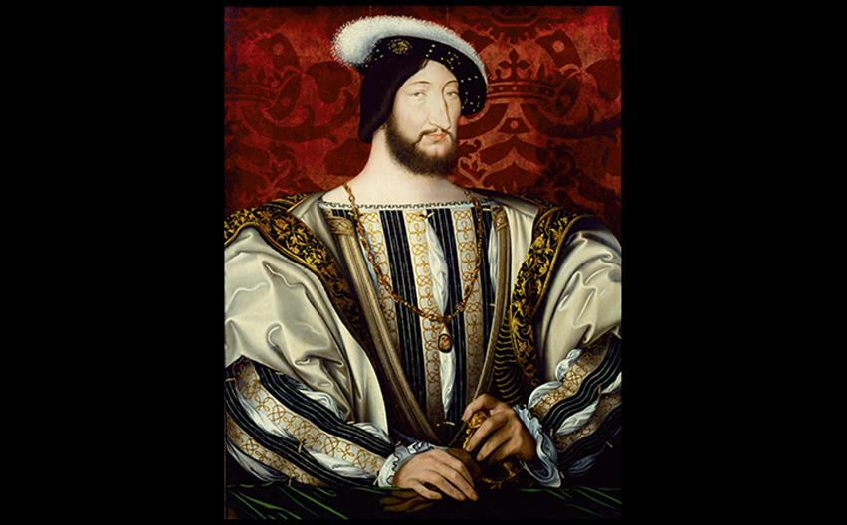
Jean Clouet FRANCIS I 1525–1530. Oil and tempera on wood panel, 37-3/4" × 29-1/8" (95.9 × 74 cm). Musée du Louvre, Paris. © 2016. Photo Scala, Florence.
Notes:
Jean Clouet FRANCIS I 1525–1530. Oil and tempera on wood panel, 37-3/4" × 29-1/8" (95.9 × 74 cm). Musée du Louvre, Paris. © 2016. Photo Scala, Florence

Slide 37
Royal Residences (1 of 3)
The Château of Chenonceau
Architects were quick to introduce Italianate decoration to otherwise Gothic buildings.
Thomas Bohier demolished the old castle and left only a tower.
Although not originally built as a royal residence, Chenonceau soon belonged to Francis I after its completion.

Slide 38
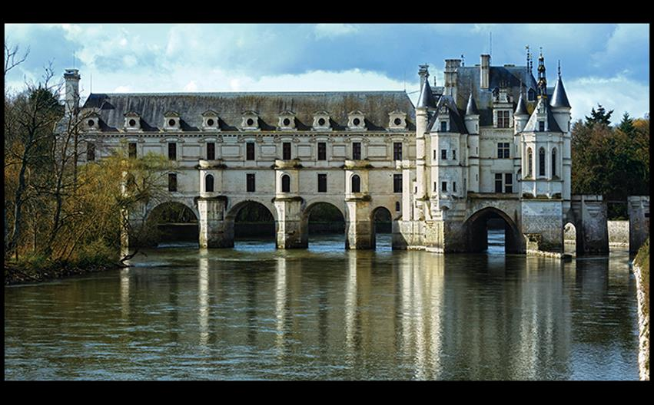
CHÂTEAU OF CHENONCEAU Touraine, France. Original building (at right) 1513–1521; gallery on bridge at left by Philibert de l'Orme, finished c. 1581. Wildman/Fotolia.
Notes:
CHÂTEAU OF CHENONCEAU Touraine, France. Original building (at right) 1513–1521; gallery on bridge at left by Philibert de l'Orme, finished c. 1581. Wildman/Fotolia.

Slide 39
Royal Residences (2 of 3)
Fontainebleau
Rosso Fiorentino and Francesco Primaticcio worked to decorate the medieval hunting lodge at Fontainebleau.
Stucco nymphs with spiraling postures are playful, erotic interior elements.
This work established an Italianate tradition of Mannerist painting and interior design.

Slide 40
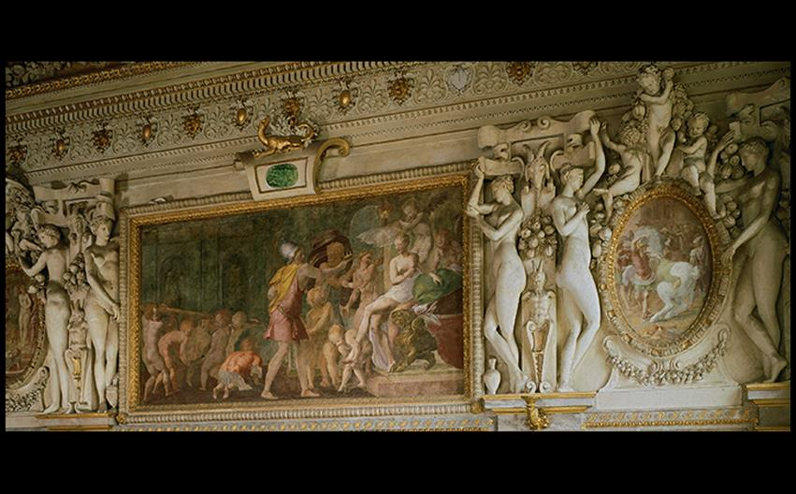
Primaticcio STUCCO AND WALL PAINTING, CHAMBER OF THE DUCHESS OF ÉTAMPES, CHÂTEAU OF FONTAINEBLEAU France. 1540s. Photo © RMN-Grand Palais (Château de Fontainebleau)/Jean-Pierre Lagiewski
Notes:
Primaticcio STUCCO AND WALL PAINTING, CHAMBER OF THE DUCHESS OF ÉTAMPES, CHÂTEAU OF FONTAINEBLEAU France. 1540s. Photo © RMN-Grand Palais (Château de Fontainebleau)/Jean-Pierre Lagiewski

Slide 41
Royal Residences (3 of 3)
The Louvre
The king's move to the capital of Paris gave birth to a style of French Classicism.
The west wing, or Cour Carrée, of the Louvre incorporated Renaissance ideals of balance and regularity with Classical architectural details.
Italian loggia mixes with the French Flamboyant style.

Slide 42
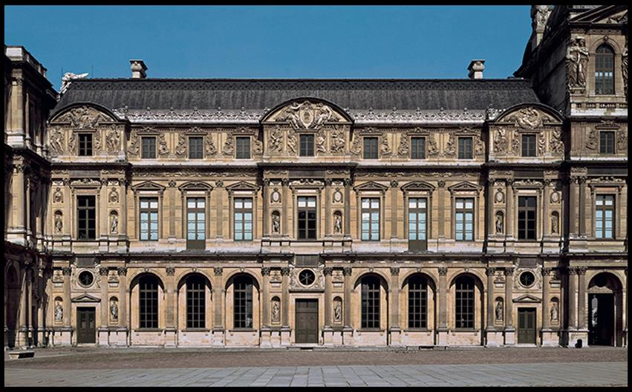
Pierre Lescot and Jean Goujon WEST WING OF THE COUR CARRÉE, PALAIS DU LOUVRE, PARIS Begun 1546. © akg-images/Erich Lessing.
Notes:
Pierre Lescot and Jean Goujon WEST WING OF THE COUR CARRÉE, PALAIS DU LOUVRE, PARIS Begun 1546. © akg-images/Erich Lessing.

Slide 43
Spain and Portugal
The marriage of Isabella of Castile and Ferdinand of Aragon began a powerful reign in Spain that lasted through their great-grandson, Philip II.
Philip II supported artists in Spain, Italy, and the Netherlands.

Slide 44
Architecture
The Escorial was a palace complex outside Madrid.
Juan Bautista de Toledo supervised the design, but Philip II guaranteed its grandeur.
Juan de Herrera added to the design with second stories on all wings and a central frontispiece.

Slide 45
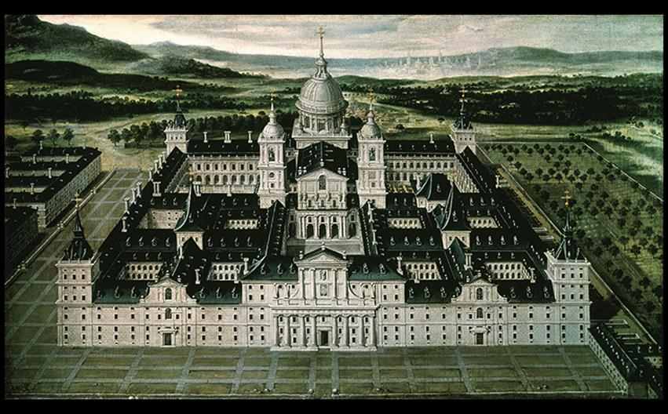
Juan Bautista de Toledo and Juan de Herrera THE ESCORIAL Madrid. 1563–1584. Detail from an anonymous 17th-century painting. Oil on canvas, 30-1/4 × 35-7/8” (77 × 91 cm). Monasterio-Pintura, San Lorenzo Del Escorial, Madrid. © akg-images/Album/Oronoz
Notes:
Juan Bautista de Toledo and Juan de Herrera THE ESCORIAL Madrid. 1563–1584. Detail from an anonymous 17th-century painting. Oil on canvas, 30-1/4 × 35-7/8” (77 × 91 cm). Monasterio-Pintura, San Lorenzo Del Escorial, Madrid. © akg-images/Album/Oronoz

Slide 46
Sculpture
The West Window from the Church in the Convent of Christ, Tomar is an unexpected detail in the Church of the Knights of Christ.
Diogo de Arruda worked in the "Manueline" style, carving every detail associated with the sea.
The amillary sphere, a complex celestial globe, was a symbol of the era.

Slide 47
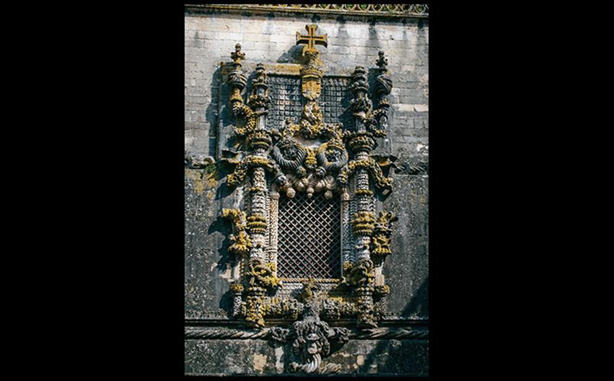
Diogo de Arruda WEST WINDOW, CHURCH IN THE CONVENT OF CHRIST, TOMAR Portugal. c. 1510. Commissioned by King Manuel I of Portugal. Lemtal/Fotolia.
Notes:
Diogo de Arruda WEST WINDOW, CHURCH IN THE CONVENT OF CHRIST, TOMAR Portugal. c. 1510. Commissioned by King Manuel I of Portugal. Lemtal/Fotolia.

Slide 48
Painting
Domenikos Theotokopoulos was the most famous painter at the end of the sixteenth century.
Nicknamed "El Greco," he joined the circle of humanist scholars after failing to gain a position at court.
The Burial of Count Orgaz captures a miraculous ascent of Orgaz into heaven.
It utilizes a Mannerist composition.

Slide 49
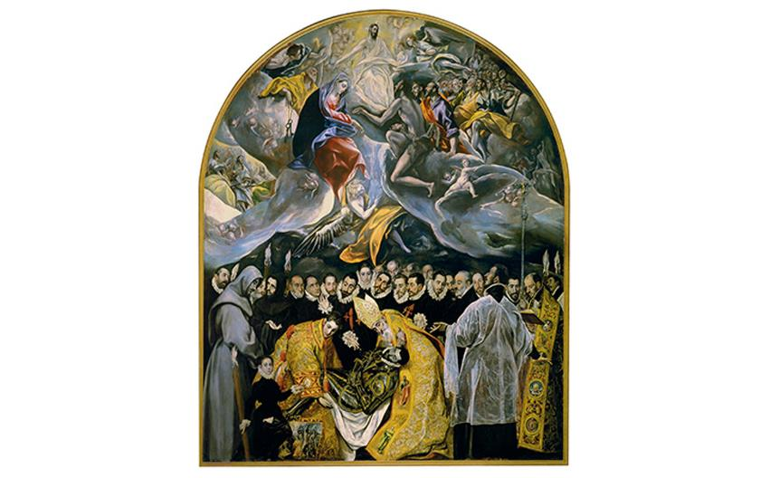
El Greco BURIAL OF COUNT ORGAZ Church of Santo Tomé, Toledo, Spain. 1586. Oil on canvas, 16' × 11'10" (4.88 × 3.61 m). Courtesy of Marilyn Stokstad.
Notes:
El Greco BURIAL OF COUNT ORGAZ Church of Santo Tomé, Toledo, Spain. 1586. Oil on canvas, 16' × 11'10" (4.88 × 3.61 m). Courtesy of Marilyn Stokstad

Slide 50
The Netherlands
Widespread iconoclasm swept the Netherlands from 1566–1567, followed by a battle for independence.
Antwerp developed into a thriving art center because artists sought patrons outside the Church.
The graphic arts emerged as an important medium.

Slide 51
Painting for Aristocratic and Noble Patrons (1 of 4)
Taste varied widely among the wealthy bourgeoisie.
Bosch captured imaginative visions while Jan Gossaert composed Italianate works.
Hieronymus Bosch
Bosch was a superb colorist and technician, creating unsettling paintings like the Garden of Earthly Delights.

Slide 52
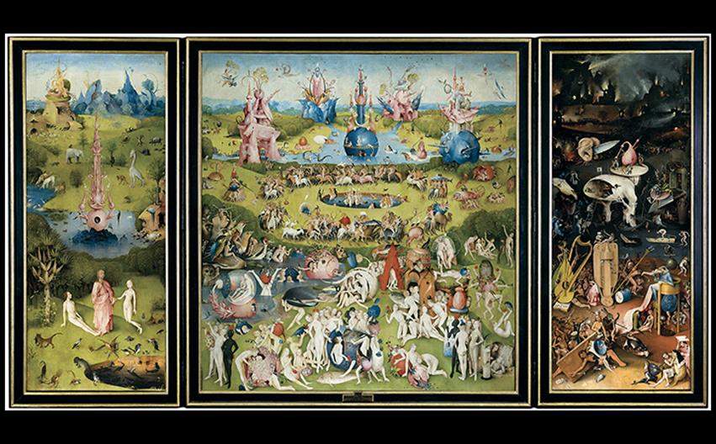
Hieronymus Bosch GARDEN OF EARTHLY DELIGHTS (OPEN) c. 1505–1515. Oil on wood panel, center panel 7'2-1/2" × 6'4-3/4" (2.20 × 1.95 m), each wing 7'2-1/2" × 3'2" (2.20 × 0.97 m). Museo del Prado, Madrid. © 2016. Image copyright Museo Nacional del Prado. © Photo MNP/Scala, Florence.
Notes:
Hieronymus Bosch GARDEN OF EARTHLY DELIGHTS (OPEN) c. 1505–1515. Oil on wood panel, center panel 7'2-1/2" × 6'4-3/4" (2.20 × 1.95 m), each wing 7'2-1/2" × 3'2" (2.20 × 0.97 m). Museo del Prado, Madrid. © 2016. Image copyright Museo Nacional del Prado. © Photo MNP/Scala, Florence.

Slide 53
Painting for Aristocratic and Noble Patrons (2 of 4)
Hieronymus Bosch
The left wing presents Adam and Eve under the watchful eye of the owl.
The central teems with human revelers and huge fruits.
The right panel shows sensual pleasures as instruments of dark torture.
Theorists believe the fountain may refer to an alchemical "marrying chamber."

Slide 54
Painting for Aristocratic and Noble Patrons (3 of 4)
Hieronymus Bosch
Conforming to the tradition of triptych altarpieces, Bosch painted a grisaille picture on the reverse of the side wings.
A tiny crowned figure of God the Creator hovers in a bubble to the side of a floating sphere.
The choice of triptych was ironic, as it was commissioned for an aristocrat's home setting.

Slide 55
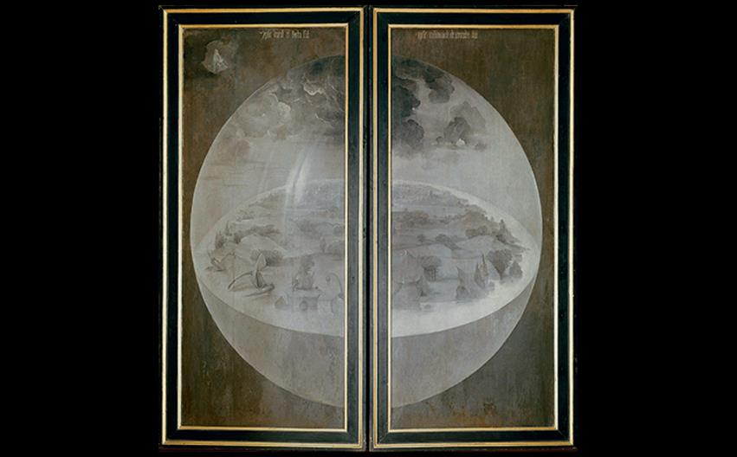
Hieronymus Bosch GARDEN OF EARTHLY DELIGHTS (CLOSED) © 2016. Photo Scala, Florence.
Notes:
Hieronymus Bosch GARDEN OF EARTHLY DELIGHTS (CLOSED) © 2016. Photo Scala, Florence.

Slide 56
Painting for Aristocratic and Noble Patrons (4 of 4)
Jan Gossaert
Gossaert utilized a "Romanizing," style evident in St. Luke Drawing the Virgin Mary.
The subjects Mary and Christ appear in a blaze of golden light.
Around Luke, dense ornament of foliage and medallions surround a statue of Moses holding the Tablets of the Law.

Slide 57
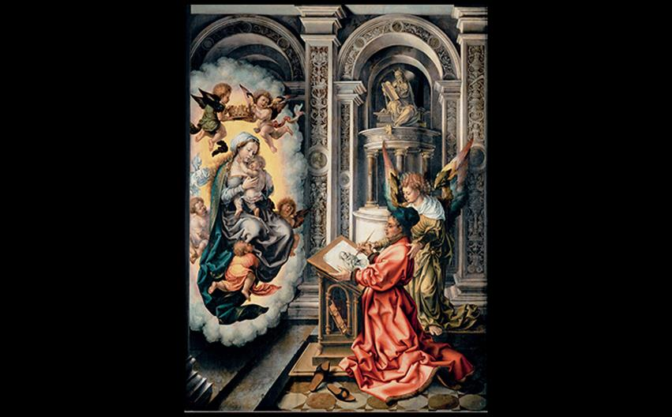
Jan Gossaert ST. LUKE DRAWING THE VIRGIN MARY 1520. Oil on panel, 43-3/8" × 32-1/4" (110.2 × 81.9 cm). Kunsthistorisches Museum, Vienna. © akg-images/Erich Lessing.
Notes:
Jan Gossaert ST. LUKE DRAWING THE VIRGIN MARY 1520. Oil on panel, 43-3/8" × 32-1/4" (110.2 × 81.9 cm). Kunsthistorisches Museum, Vienna. © akg-images/Erich Lessing.

Slide 58
Antwerp (1 of 5)
The deep port of Antwerp made it an international center of trade as well as the financial center of Europe.
Demand for luxury goods fostered the birth of the art market.
Many artists became specialists in one area.

Slide 59
Antwerp (2 of 5)
Quentin Massys
Massys entered the Antwerp painters' guild in 1491 after starting his career as a blacksmith.
Money Changer and His Wife relays the moral of just business practices as a form of righteous living just as much as devotional practice.

Slide 60
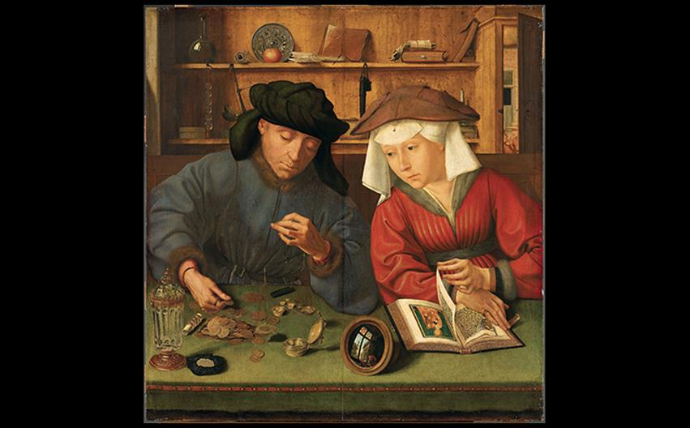
Quentin Massys MONEY CHANGER AND HIS WIFE 1514. Oil on panel, 28" × 26-3/4" (71.2 × 68 cm). Kunsthistorisches Museum, Vienna. Photo © RMN-Grand Palais (Musée du Louvre)/Tony Querrec
Notes:
Quentin Massys MONEY CHANGER AND HIS WIFE 1514. Oil on panel, 28" × 26-3/4" (71.2 × 68 cm). Kunsthistorisches Museum, Vienna. Photo © RMN-Grand Palais (Musée du Louvre)/Tony Querrec.

Slide 61
Antwerp (3 of 5)
Caterina van Hemessen
Having learned to paint from her father, van Hemessen owns her own style of quiet realism.
Her Self-Portrait shows a serious young person who interrupts her portrait of a young woman client to look at the viewer.
She became a favored court artist to Mary of Hungary.

Slide 62
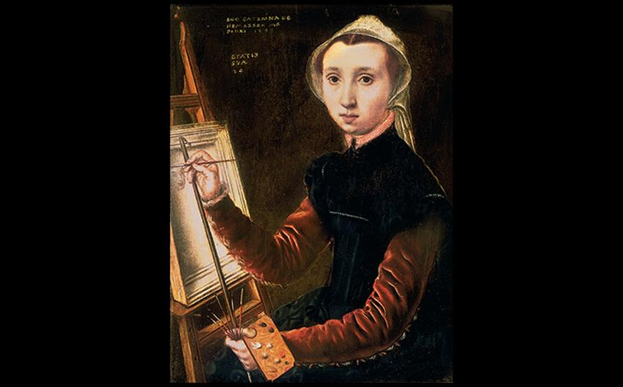
Caterina van Hemessen SELF-PORTRAIT 1548. Oil on wood panel, 12-1/4" × 9-1/4" (31.1 × 23.5 cm). Öffentliche Kunstsammlung, Basel. Photo: Martin Buhler/Kunstmuseum Basel.
Notes:
Caterina van Hemessen SELF-PORTRAIT 1548. Oil on wood panel, 12-1/4" × 9-1/4" (31.1 × 23.5 cm). Öffentliche Kunstsammlung, Basel. Photo: Martin Buhler/Kunstmuseum Basel.

Slide 63
Antwerp (4 of 5)
Pieter Bruegel the Elder
Bruegel imitated the works of Hieronymus Bosch early in his career.
After having traveled Italy, he did not record the ruins of Rome but rather the landscapes of Alpine valleys.
His Cycle of the Months depicts nature in all seasons and moods.

Slide 64
Antwerp (5 of 5)
Pieter Bruegel the Elder
Return of the Hunters represents December and January with a bleak, snow-covered landscape.
In contrast, The Harvesters presents workers enjoying the good life on their break during August and September.
Both are tied by their use of trees in the foreground, and both invite comparison to medieval works.

Slide 65
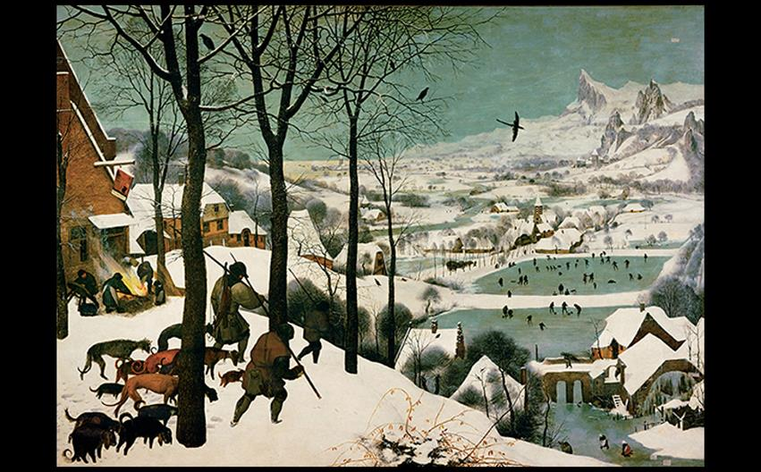
Pieter Bruegel the Elder RETURN OF THE HUNTERS 1565. Oil on wood panel, 3'10-1/2" × 5'3-3/4" (1.18 × 1.61 m). Kunsthistorisches Museum, Vienna. © akg-images/Erich Lessing.
Notes:
Pieter Bruegel the Elder RETURN OF THE HUNTERS 1565. Oil on wood panel, 3'10-1/2" × 5'3-3/4" (1.18 × 1.61 m). Kunsthistorisches Museum, Vienna. © akg-images/Erich Lessing.

Slide 66
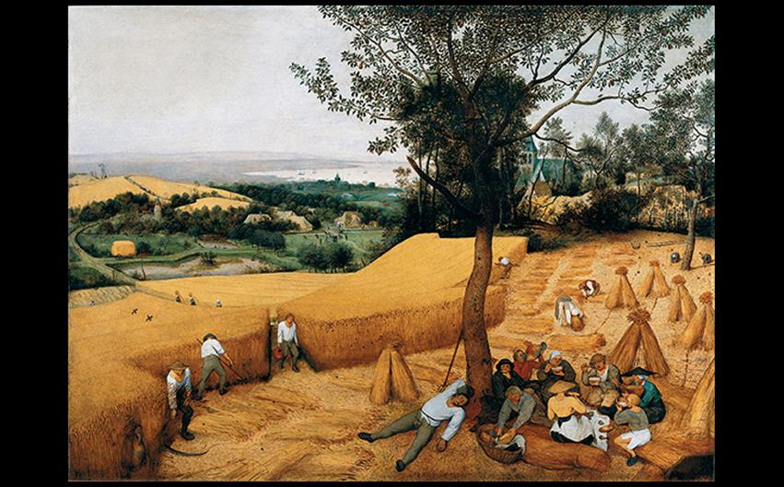
Pieter Bruegel the Elder THE HARVESTERS 1565. Oil on wood panel, 46-7/8" × 63-3/4" (1.17 × 1.6 m). Metropolitan Museum of Art, New York. Rogers Fund, 1919. (19.164). © 2016. Image copyright The Metropolitan Museum of Art, New York/Art Resource, NY/Scala, Florence.
Notes:
Pieter Bruegel the Elder THE HARVESTERS 1565. Oil on wood panel, 46-7/8" × 63-3/4" (1.17 × 1.6 m). Metropolitan Museum of Art, New York. Rogers Fund, 1919. (19.164). © 2016. Image copyright The Metropolitan Museum of Art, New York/Art Resource, NY/Scala, Florence.

Slide 67
England
Tudor England continued support of the arts despite the disruption of the Reformation.
After a brief Catholic period during Mary's reign, England was claimed as a Protestant country when Elizabeth ascended to the throne in 1558.

Slide 68
Artists in the Tudor Court (1 of 3)
Tudors favored Netherlandish and German artists for their portraits.
Hans Holbein
Holbein created a series of portraits of nobles and diplomats associated with the Tudor court.
Details in textures and the intellectual gifts displayed around these two men emphasizes Holbein's technical skill.

Slide 69
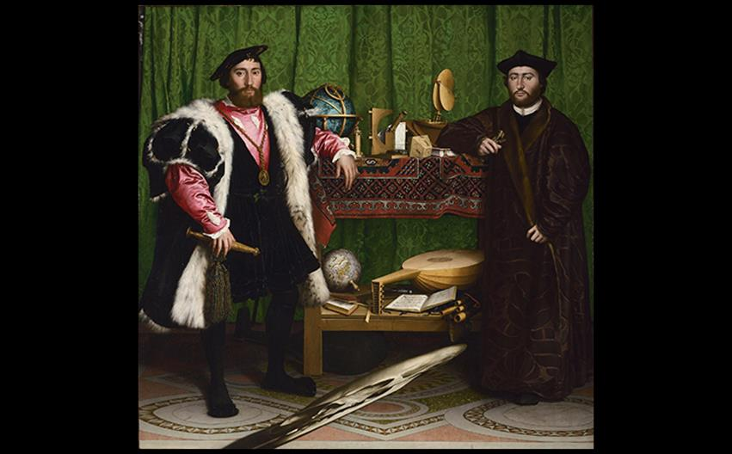
A CLOSER LOOK: The French Ambassadors by Hans Holbein the Younger 1533. Oil on wood panel. 81-1/8" × 82-5/8" (2.07 × 2.1 m). National Gallery, London. © 2016. Copyright The National Gallery, London/Scala, Florence.
Notes:
A CLOSER LOOK: The French Ambassadors by Hans Holbein the Younger 1533. Oil on wood panel. 81-1/8" × 82-5/8" (2.07 × 2.1 m). National Gallery, London. © 2016. Copyright The National Gallery, London/Scala, Florence.

Slide 70
Artists in the Tudor Court (2 of 3)
Portraits of Elizabeth
The queen carefully controlled the way artists represented her in portraits.
The Ditchley Portrait by Marcus Gheeraerts emphasizes the look she was after.
The whiteness of her elaborate dress stands out against a passing storm, highlighting her virginal purity.

Slide 71
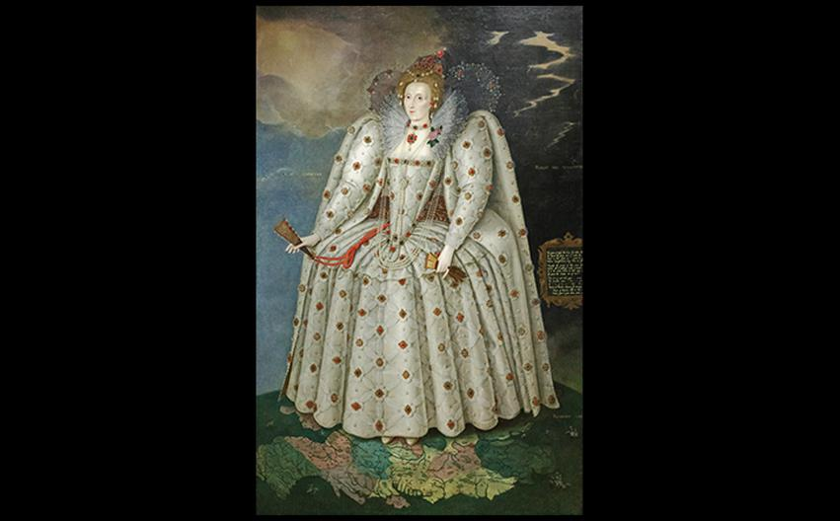
Marcus Gheeraerts the Younger QUEEN ELIZABETH I (THE DITCHLEY PORTRAIT) c. 1592. Oil on canvas, 95" × 60" (2.4 × 1.5 m). National Portrait Gallery, London. Photo © Stefano Baldini/Bridgeman Images.
Notes:
Marcus Gheeraerts the Younger QUEEN ELIZABETH I (THE DITCHLEY PORTRAIT) c. 1592. Oil on canvas, 95" × 60" (2.4 × 1.5 m). National Portrait Gallery, London. Photo © Stefano Baldini/Bridgeman Images.

Slide 72
Artists in the Tudor Court (3 of 3)
Nicholas Hilliard
Hilliard never received a court appointment, despite creating miniature portraits of the queen and her court.
George Clifford's portrait shows the earl of Bumberland in a richly engraved suit of armor.
He is humanized by his direct gaze and receding hairline.

Slide 73
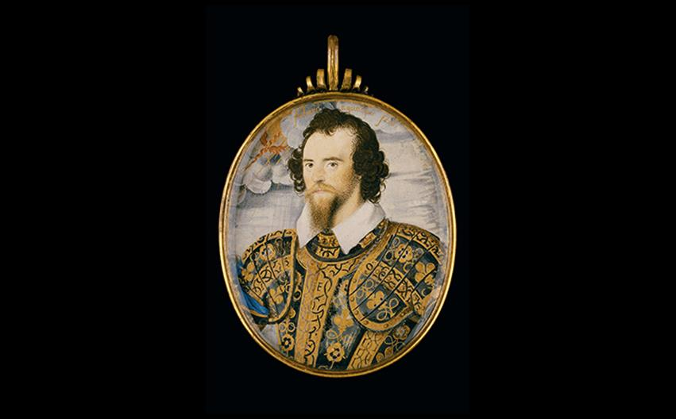
Nicholas Hilliard GEORGE CLIFFORD, THIRD EARL OF CUMBERLAND c. 1595. Watercolor on vellum on card, oval 2-3/4" × 2-3/16" (7.1 × 5.8 cm). The Nelson-Atkins Museum of Art, Kansas City, Missouri. Gift of Mr. and Mrs. John W. Starr through the Starr Foundation. F58-60/188
Notes:
Nicholas Hilliard GEORGE CLIFFORD, THIRD EARL OF CUMBERLAND c. 1595. Watercolor on vellum on card, oval 2-3/4" × 2-3/16" (7.1 × 5.8 cm). The Nelson-Atkins Museum of Art, Kansas City, Missouri. Gift of Mr. and Mrs. John W. Starr through the Starr Foundation. F58-60/188

Slide 74
Architecture (1 of 2)
Henry VIII granted titles to rich landowners, which incited them to display their wealth by constructing lavish country residences.
John Shute wrote the first architectural manual in 1563.
Italian architect Sebastiano Serlio also wrote influential treatises on architectural design.

Slide 75
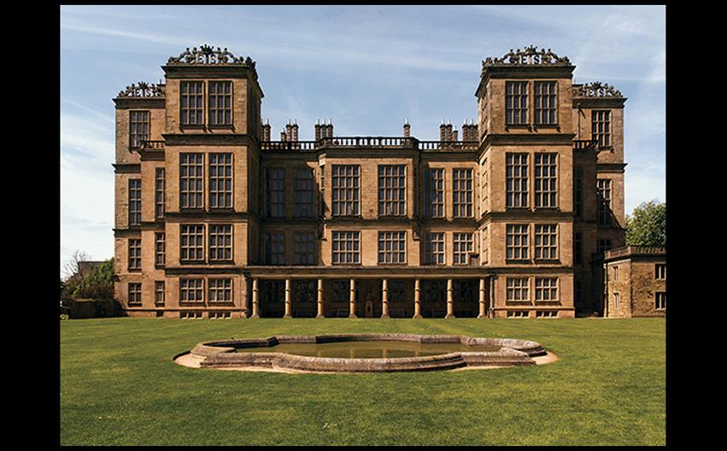
Robert Smythson HARDWICK HALL Derbyshire, England. 1591–1597. © Phil MacD Photography/Shutterstock.
Notes:
Robert Smythson HARDWICK HALL Derbyshire, England. 1591–1597. © Phil MacD Photography/Shutterstock.

Slide 76
Art and Its Contexts: Armor of Royal Games
Accession Day Tilts were popular festivals celebrating the anniversary of Elizabeth I's coming to the throne.
Gentlemen held mock battles and wore elegant, finely-detailed armor.
Exchange pieces allowed the owner to vary his appearance by changing certain parts of the suit of armor as well as provided backups.

Slide 77
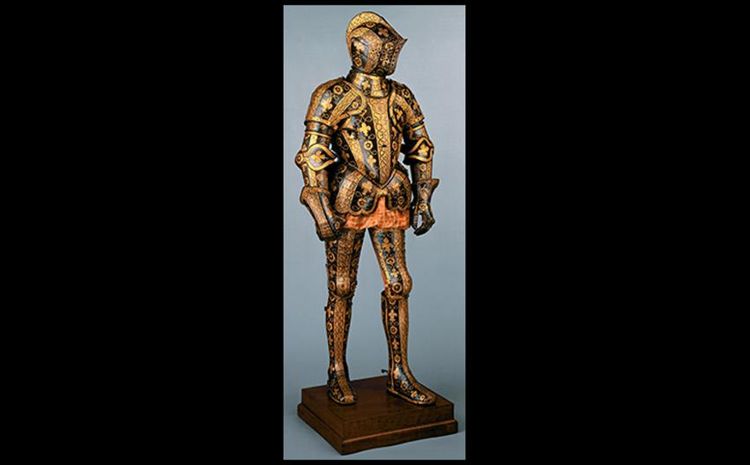
Jacob Halder ARMOR OF GEORGE CLIFFORD, THIRD EARL OF CUMBERLAND Made in the royal workshop at Greenwich, England. c. 1580–1583. Steel and gold, height 5'9-1/2" (1.77 m). Metropolitan Museum of Art, New York. Munsey Fund, 1932 (32.130.6). © 2016. Image copyright The Metropolitan Museum of Art/Art Resource/Scala, Florence.
Notes:
Jacob Halder ARMOR OF GEORGE CLIFFORD, THIRD EARL OF CUMBERLAND Made in the royal workshop at Greenwich, England. c. 1580–1583. Steel and gold, height 5'9-1/2" (1.77 m). Metropolitan Museum of Art, New York. Munsey Fund, 1932 (32.130.6). © 2016. Image copyright The Metropolitan Museum of Art/Art Resource/Scala, Florence.

Slide 78
Architecture (2 of 2)
Hardwick Hall
The countess of Shrewsbury employed Robert Smythson to build Hardwick Hall from the riches accumulated from her four deceased husbands.
The High Great Chamber on the second floor featured an ornately carved fireplace.
High windows illuminated the interior.

Slide 79
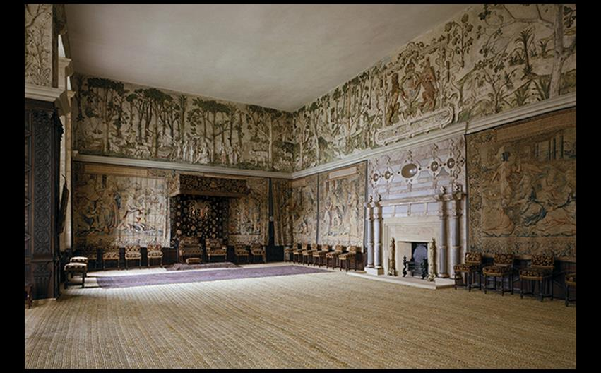
Robert Smythson HIGH GREAT CHAMBER, HARDWICK HALL Derbyshire, England. 1591–1597. Brussels tapestries 1550s; painted plaster sculpture by Abraham Smith. National Trust Photographic Library/Andreas von Einsiedel/Bridgeman Images.
Notes:
Robert Smythson HIGH GREAT CHAMBER, HARDWICK HALL Derbyshire, England. 1591–1597. Brussels tapestries 1550s; painted plaster sculpture by Abraham Smith. National Trust Photographic Library/Andreas von Einsiedel/Bridgeman Images

